Slide 1
Study of the Kinetics of Hydration of Industrial Granulated Blast Furnace Slags: A Structural Investigation
Abel Danezan, Franck Fayon, Cécile Genevois, Emmanuel Véron, Mathieu Allix, Catherine Bessada, Simon Blotevogel, Laurent Steger, Martin Cyr, Cédric Patapy, Judit Kaknics, Valérie Montouillout

Slide 2






ActiSlag
New Activation Routes for Early Strength Development of Granulated Blast Furnace Slag
European project – Industrial and academic partnership
Identification of compositional factors influencing strength development in mortars
  Optimization of reactivity regarding composition and cement formulation

Slide 3
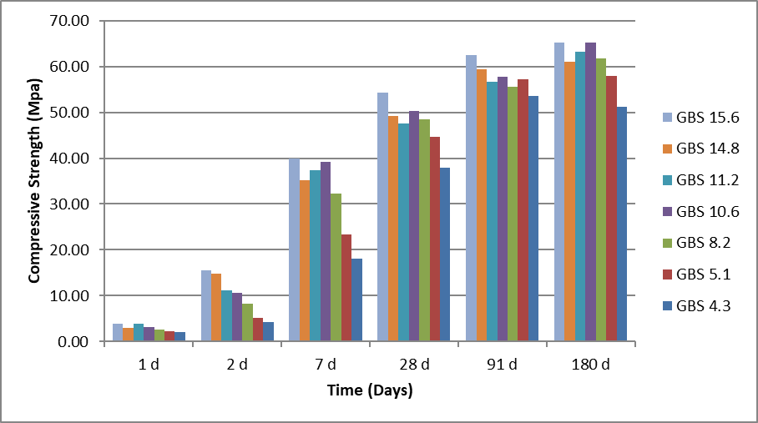

Reactivity
7 samples with different origins
7 different compressive strengths
Study of the best and worst performing
75wt% GBS and 25wt% clinker; Blaine = 4200 cm²/g
 | GBS4.3 | GBS5.1 | GBS8.2 | GBS10.6 | GBS11.2 | GBS14.8 | GBS15.6
Compressive strength (MPa) | 4.3 | 5.1 | 8.2 | 10.6 | 11.2 | 14.8 | 15.6

Slide 4
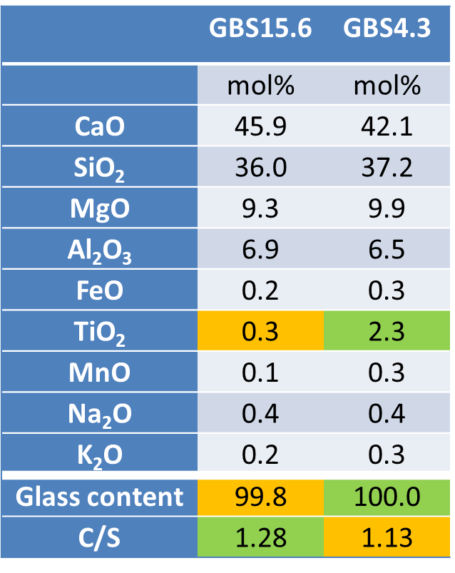
Context
Compressive strength
?
Structure
Multiscale characterization
Influence of minor elements
Micro and nanostructure of the amorphous phase
XRD
SEM
TEM
NMR

Slide 5
Crystallinity
The only crystallites observed by SEM are round Fe enriched inclusions
 | Fe | P | Ca | Si
at.-% | 97.0 | 0.9 | 1.4 | 0.6
No Fe was detected in the glass matrix
GBS4.3
GBS15.6
1µm
1µm

Slide 6
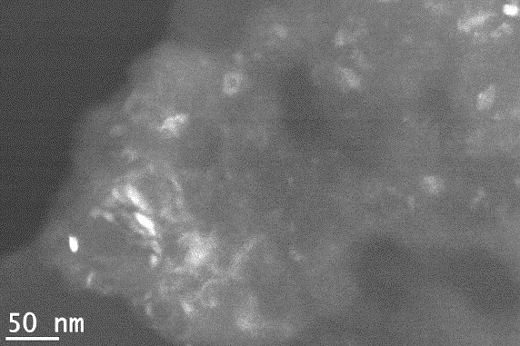
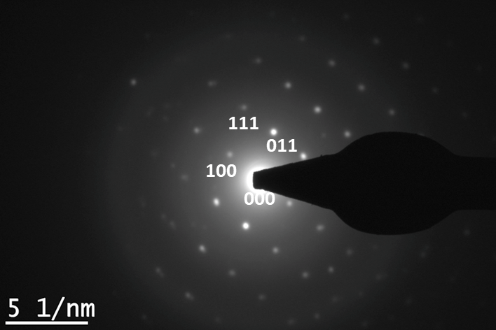
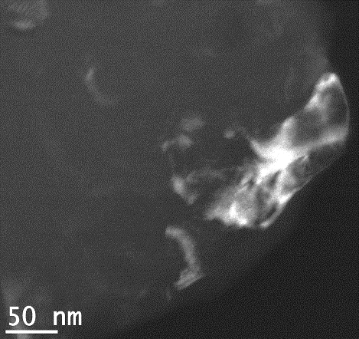
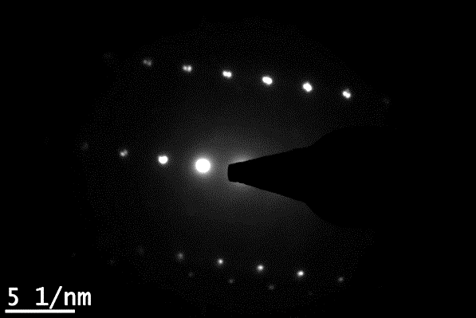

Crystallinity
Crystalline areas about 100nm were observed by TEM
Composed of numerous nanocrystals
Alpha quartz (SiO₂)
GBS4.3
SAED
Zone axis $[0\overline{1}1]$
Calcium enriched nanocrystals
GBS15.6
Dark field
Dark field

Slide 7
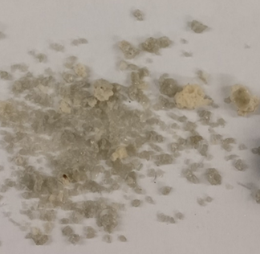
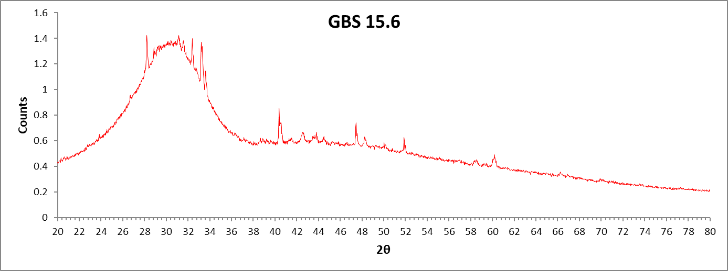
Crystallinity of GBS15.6
Best performing sample displays macroscopic heterogeneities
Dark Part
Crystalline areas of Quartz and Ca enriched nanocrystals
GBS15.6
Light Part
Difference in crystallinity

Slide 8
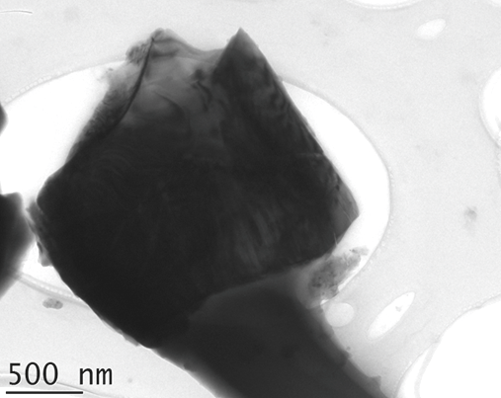
Crystallinity of GBS15.6
GBS15.6
Merwinite Ca₃Mg(SiO₂)₄
Akermanite-Gehlenite Ca₂(Al_{0.25}Mg_{0.75})((Al_{0.25}Si_{1.75})O₇)
Similar to C₂S (Cement component) in composition and hydraulic properties
  Formation of CSH (Cement hydration products)
Hydration catalyst (Kriskova et al (2014))

Slide 9
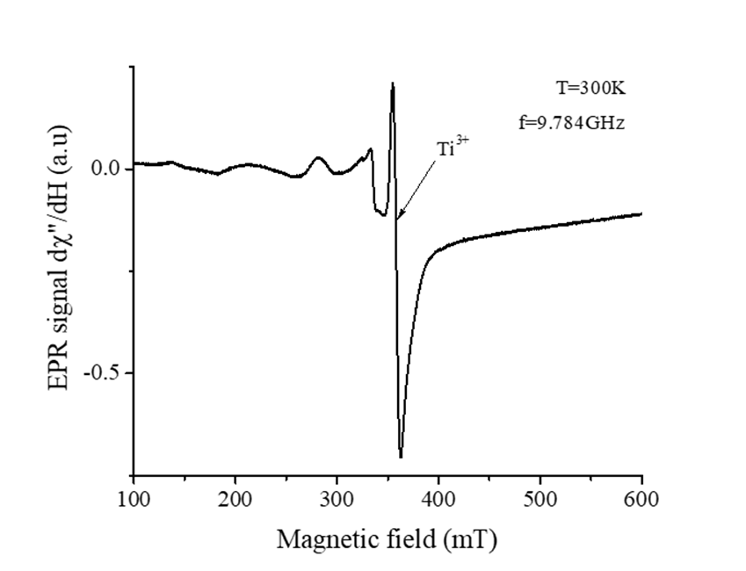

Titanium in GBS4.3
Worst performing sample has a high Ti content (2.3 mol%)
EPR investigations
Signal centered at g=1.954
  Presence of Ti³⁺, consistent with the reducing atmosphere
Ti seems to be dispersed in the glass network
Charles-Emmanuel Dutoit (CEMHTI), Hervé Vezin (LASIR)

Slide 10
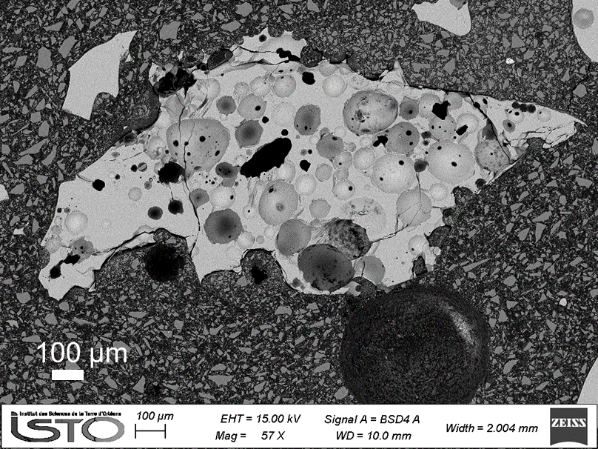
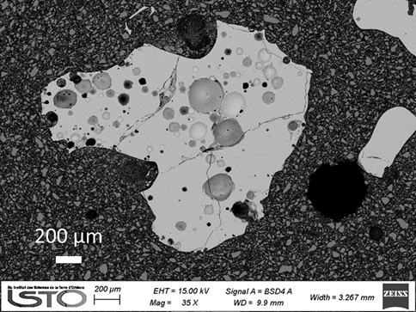
Glass network
Homogenous glass matrix
Homogenous composition from grain to grain
SEM images:
GBS4.3
GBS15.6
 | Spectrum | SiO₂ | CaO | Al₂O₃ | MgO | MnO | FeO | Na₂O | K₂O | SO₃
EDS | mol % | 36.2 | 41.6 | 8.2 | 11.7 | 0.7 | 0.3 | 0.1 | 0 | 1.1
Chemical Analysis | mol.% | 34.8 | 41.9 | 8.1 | 12.5 | 0.2 | 0.3 | 0.4 | 0.3 | 0.1

Slide 11
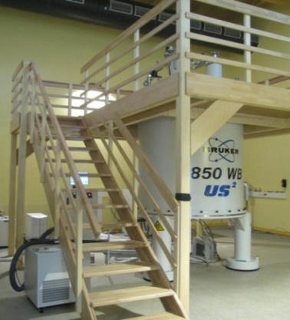
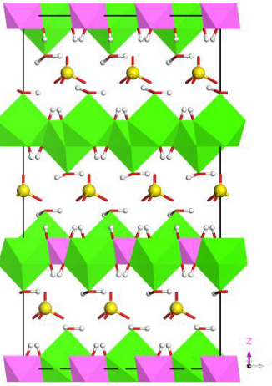
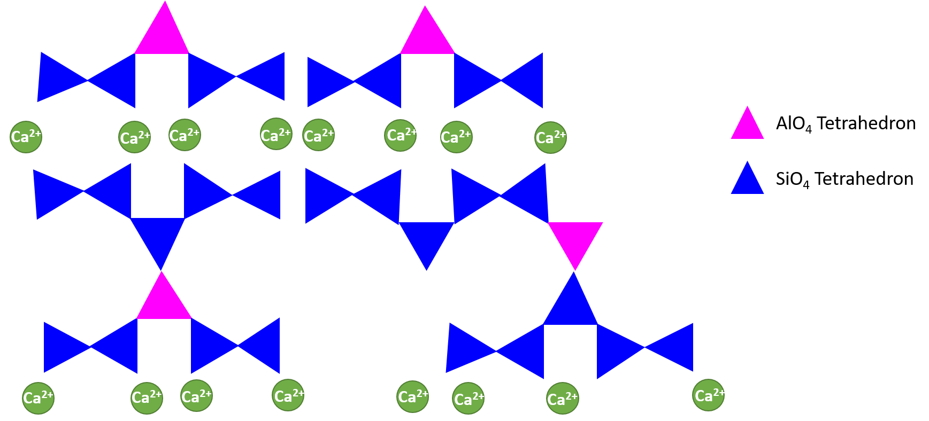
NMR
High resolution solid state NMR
Selective observation the environment of specific elements
  Global information
  both ordered and disordered environments
Environments observed:
Silicon - ²⁹Si
Aluminum - ²⁷Al
CASH
AFm
Al_{VI}
Q¹
SO₄²⁻ ; H₂O
Q²_{(1Al)}
Q²
[Ca₂Al(OH)₆]⁺
Hajilar et. al. (2015)

Slide 12
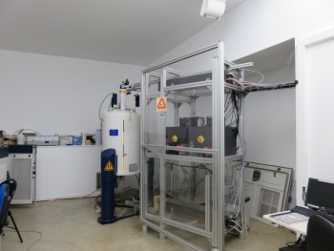
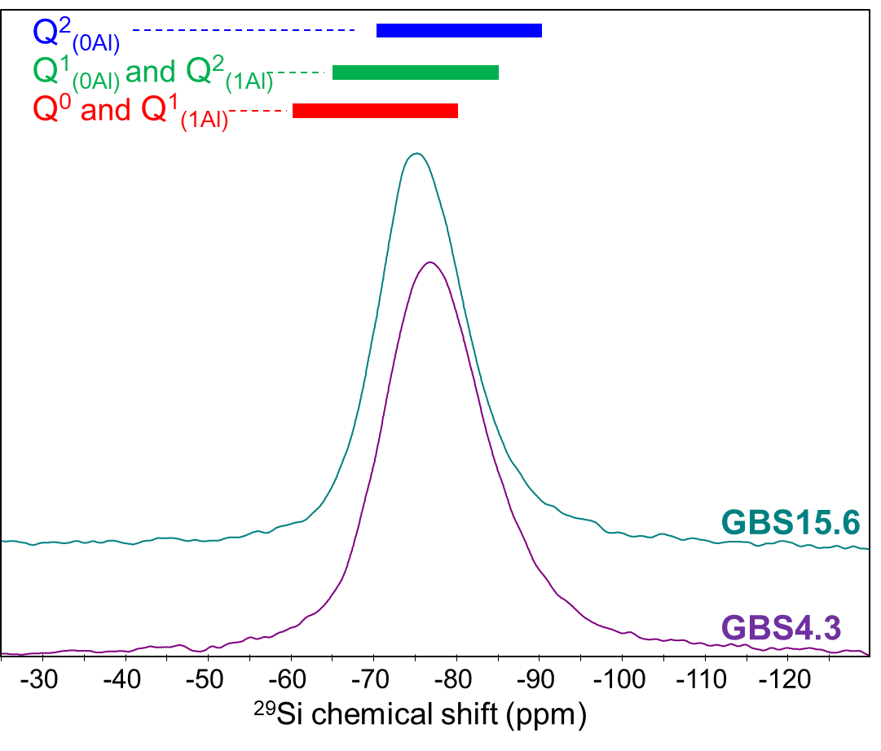
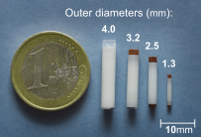
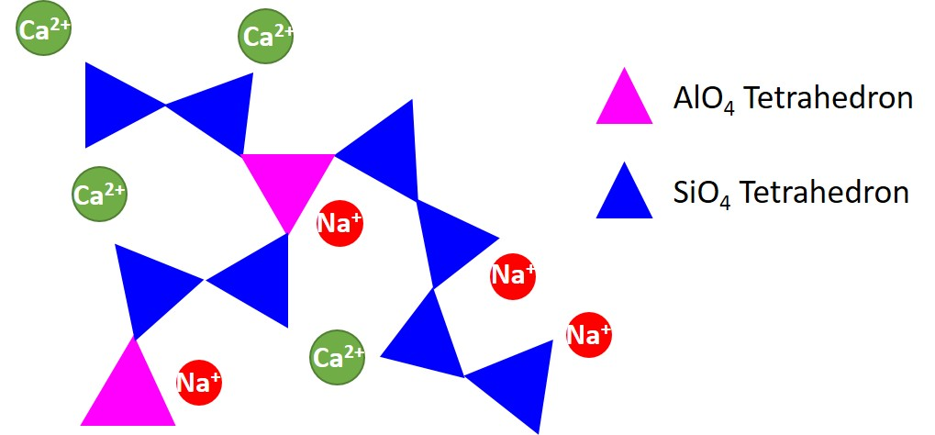
Glass network
²⁹Si MAS NMR – Silicon environment
Bruker Avance 400 Spectrometer
B₀=9.4T;ν_{rf}(²⁹Si)=79.4MHz; ν_{rot}=10kHz
Q¹
Q²_{(1Al)}
δ= −75.1ppm
Width = 12.4ppm
δ= −76.9ppm
Width = 14.2ppm
Q²
GBS15.6 displays higher chemical shift than GBS4.3
  Less polymerized glass network
Depolymerized network - Mainly Q¹_{(0Al)}, Q²_{(0Al)} and Q²_{(1Al)} (G. Engelhardt et al (1989))

Slide 13
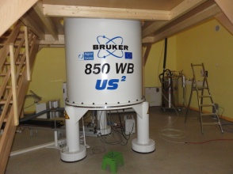
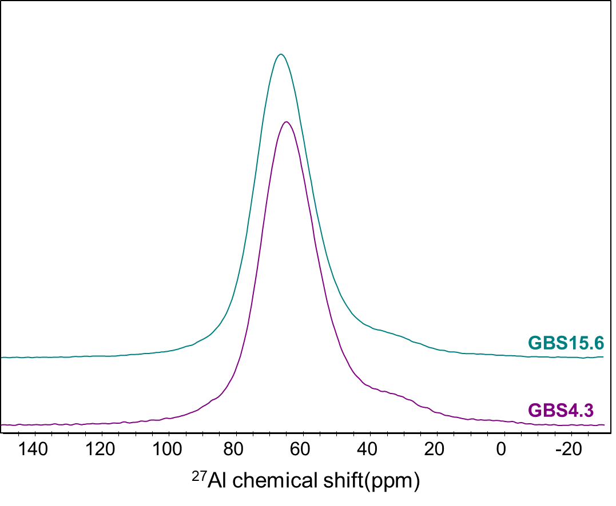
Glass network
²⁷Al MAS NMR – Aluminum environment
Bruker Avance 850 Spectrometer
B₀=20T;ν_{rf}(²⁷Al)=221.6MHz; ν_{rot}=30kHz
Al_{IV}
Quadrupolar line shape characteristic of disordered materials
In our experimental conditions, no evidence of Al in a crystalline phase
Mainly Al_{IV}, presence of Al_{V}
Al_{V}

Slide 14
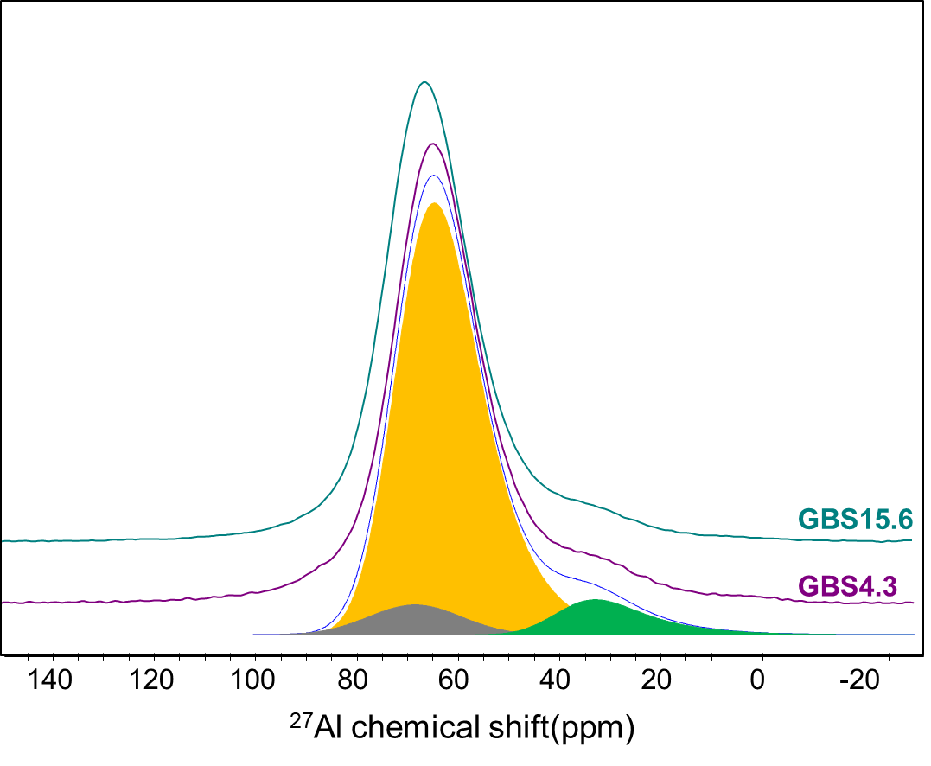
Glass network
²⁷Al MAS NMR – Aluminum environment
Bruker Avance 850 Spectrometer
B₀=20T;ν_{rf}(²⁷Al)=221.6MHz; ν_{rot}=30kHz
Al_{IV}
GBS15.6 displays higher chemical shift (73.4ppm) than GBS4.3 (71.5ppm)
GBS15.6 less polymerized than GBS4.3
Al_{V} quantities are very close in both samples (~5%)
Al_{V}
Al_{IV}
*Spinning sideband
*
Al_{V}

Slide 15
Summary
 | GBS4.3 | GBS15.6
Compressive Strength (MPa) | 4.3 | 15.6
Compositional particularity | Ti³⁺
Polymerization | highest | lowest
Additional crystalline phases |  | Merwinite and Akermanite-Gehlenite
Glassy Matrix (~99%)
GBS15.6 displays a less polymerized network compared to GBS4.3
Remarkable singularities
Ti³⁺ in the worse performing sample (GBS4.3)
Crystalline phases in the best performing sample (GBS15.6)

Slide 16
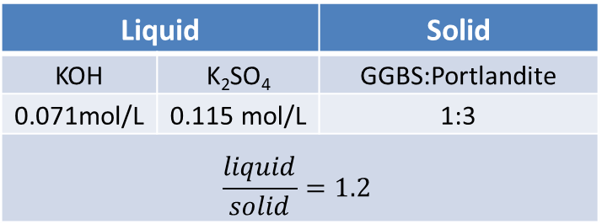
GBS hydration
No Portland cement or clinker addition
  Simpler system
  Better observation of the behavior of GBS
Cement Pore solution:
Liquid |  | Solid
KOH | K₂SO₄ | GGBS:Portlandite
0.071mol/L | 0.115 mol/L | 1:3
$$\frac{liquid}{solid}=1.2$$
Hydration stop – Solvent exchange:
  2 minutes in acetone ⇒ Buchner filtration ⇒ 15 minutes vacuum drying
Characterization after different curing times
          24h ⇒ 48h ⇒ 72h ⇒ 7 days

Slide 17
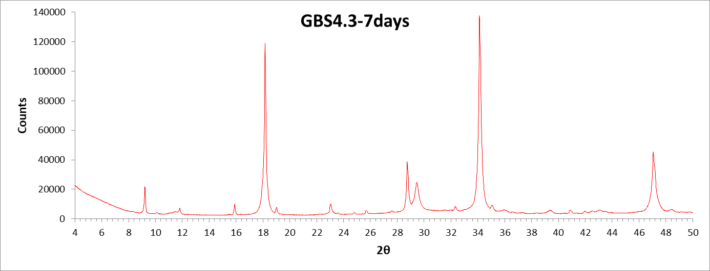
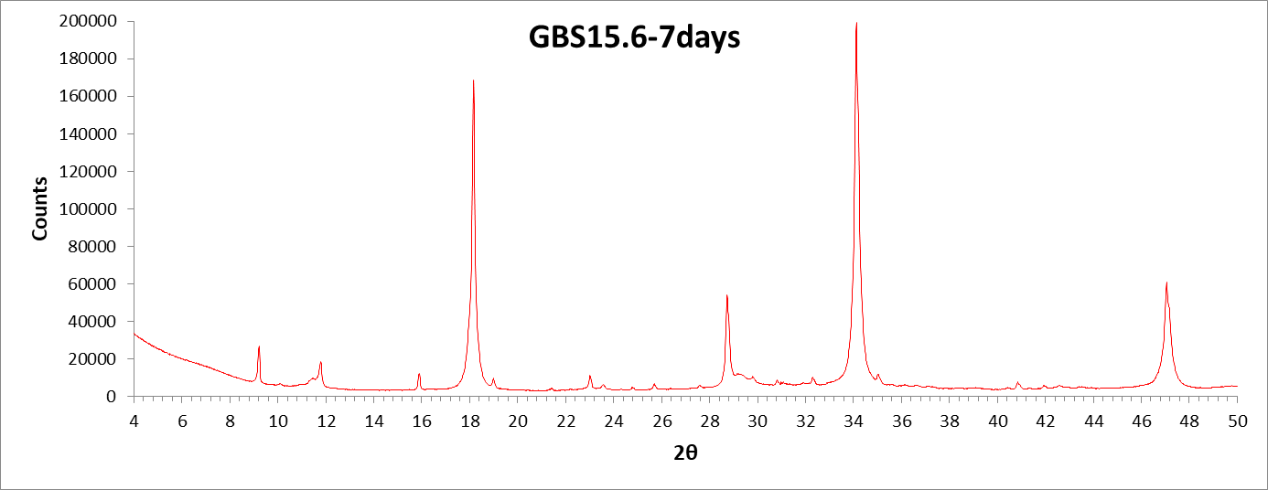
XRD
Portlandite
Ettringite
Calcite
Portlandite
Ettringite
Calcite

Slide 18
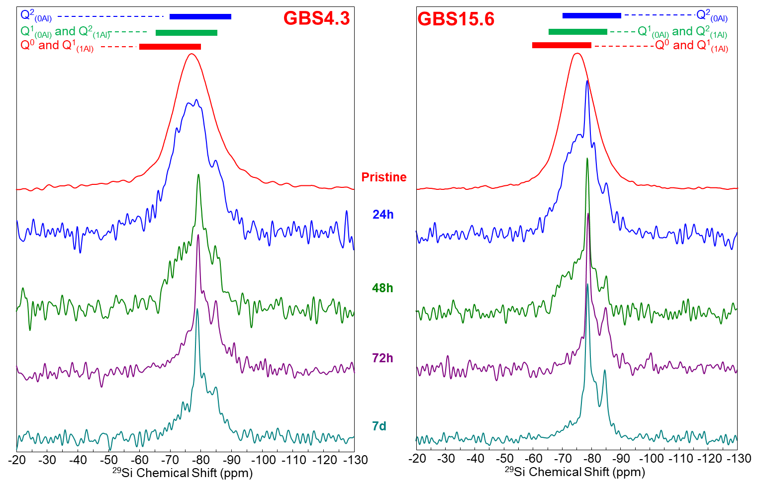
²⁹Si MAS NMR

Slide 19
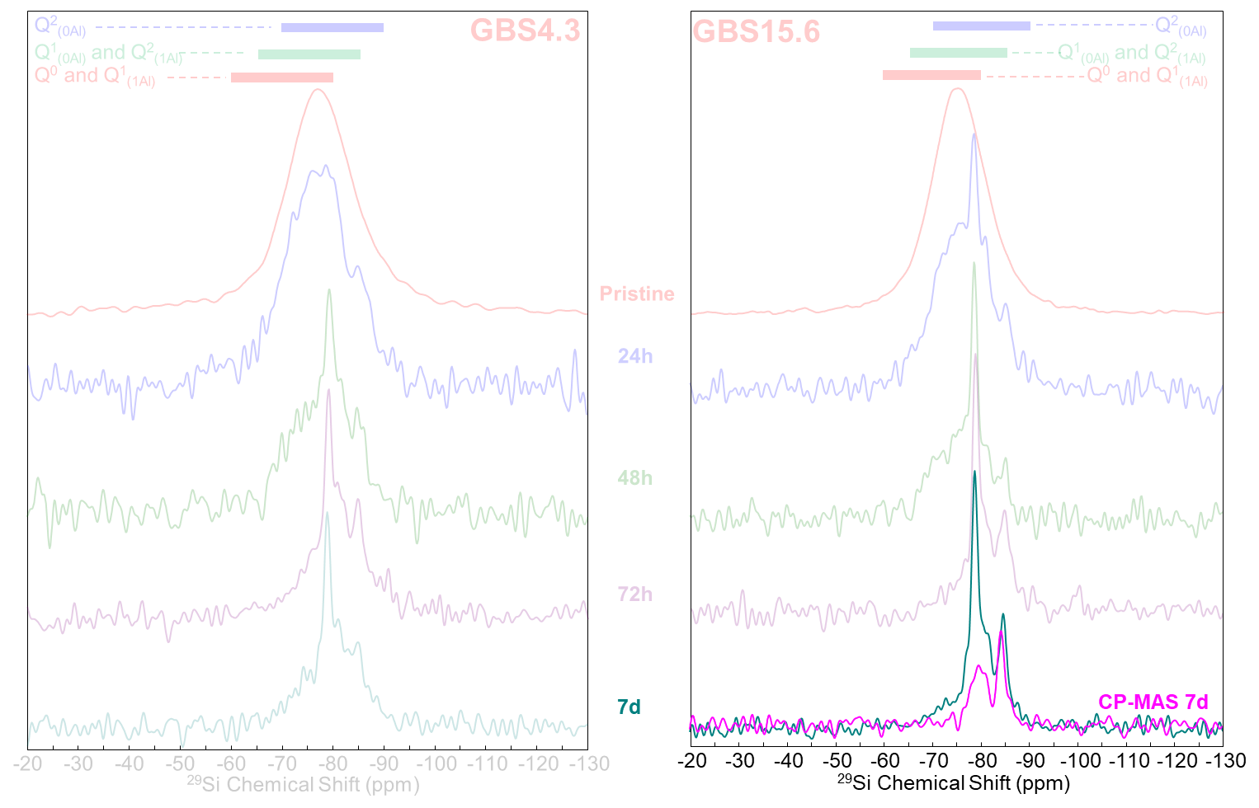
²⁹Si MAS NMR

Slide 20
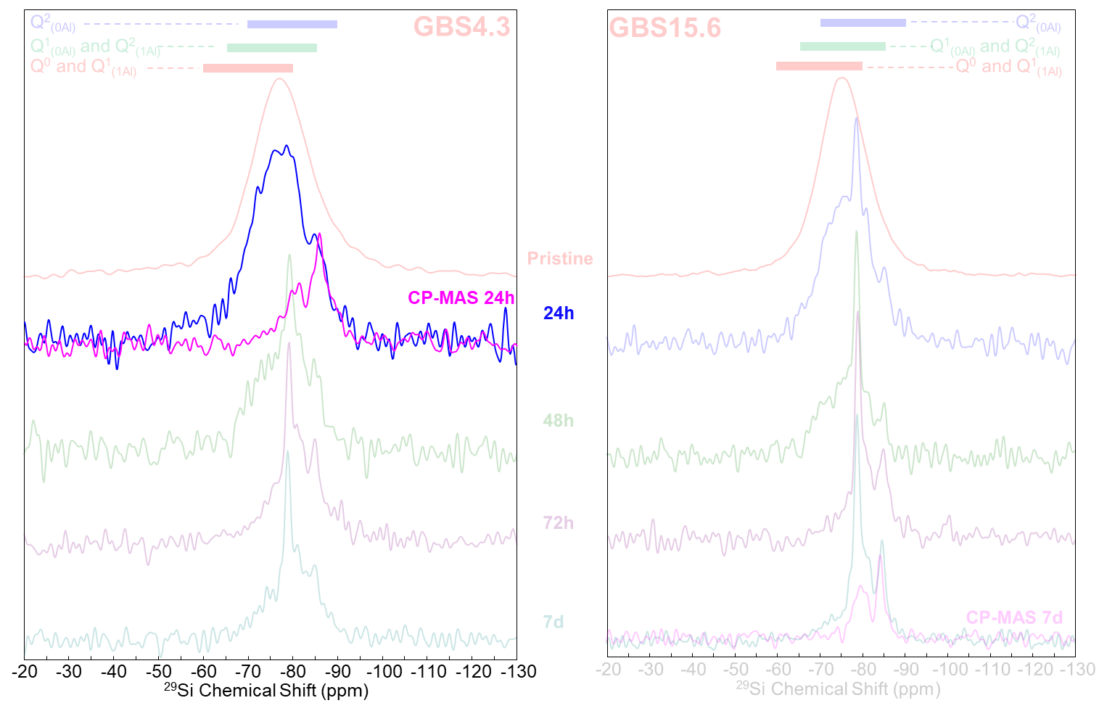
²⁹Si MAS NMR

Slide 21
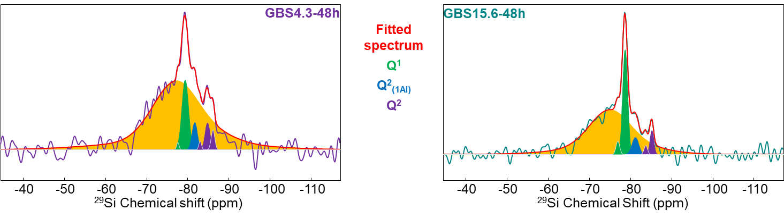
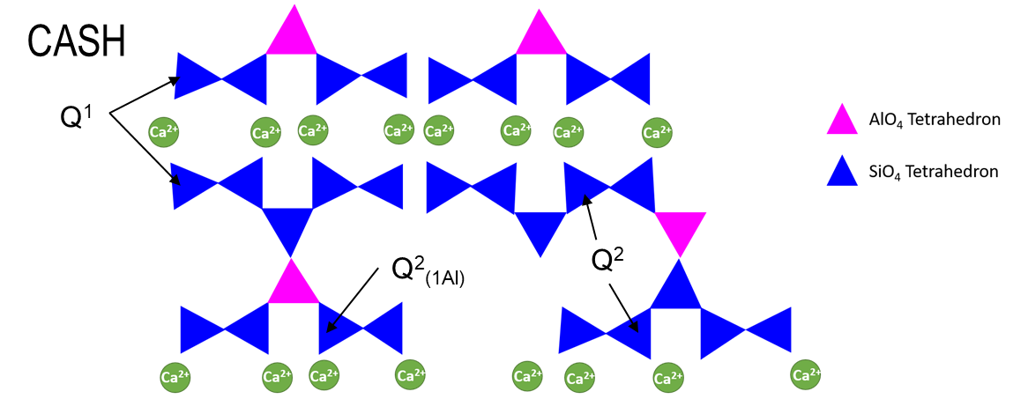
²⁹Si MAS NMR
Slag
 | GBS4.3-48h |  |  | GBS15.6-48h
 | δ_{iso} (ppm) | FWHM (ppm) | Silicon proportion (%) | δ_{iso} (ppm) | FWHM (ppm) | Silicon proportion (%)
Slag | -76.9 | 14.2 | 81 | -75.1 | 12.2 | 73
Q¹ | -77.6/-79.4 | 0.7/1.9 | 11 | -76.9/-78.7 | 1.1/1.4 | 19
Q²_{(1Al)} | -81.7/-82.9 | 1.5/0.8 | 3 | -81.1 | 1.9 | 4
Q² | -84.8/-86.1 | 1.5/1.0 | 5 | -83.7/-85.2 | 1.0/1.0 | 4

Slide 22
²⁹Si MAS NMR
Slag
 | GBS4.3-48h |  |  | GBS15.6-48h
 | δ_{iso} (ppm) | FWHM (ppm) | Silicon proportion (%) | δ_{iso} (ppm) | FWHM (ppm) | Silicon proportion (%)
Slag | -76.9 | 14.2 | 81 | -75.1 | 12.2 | 73
CASH |  |  | 19 |  |  | 27

Slide 23
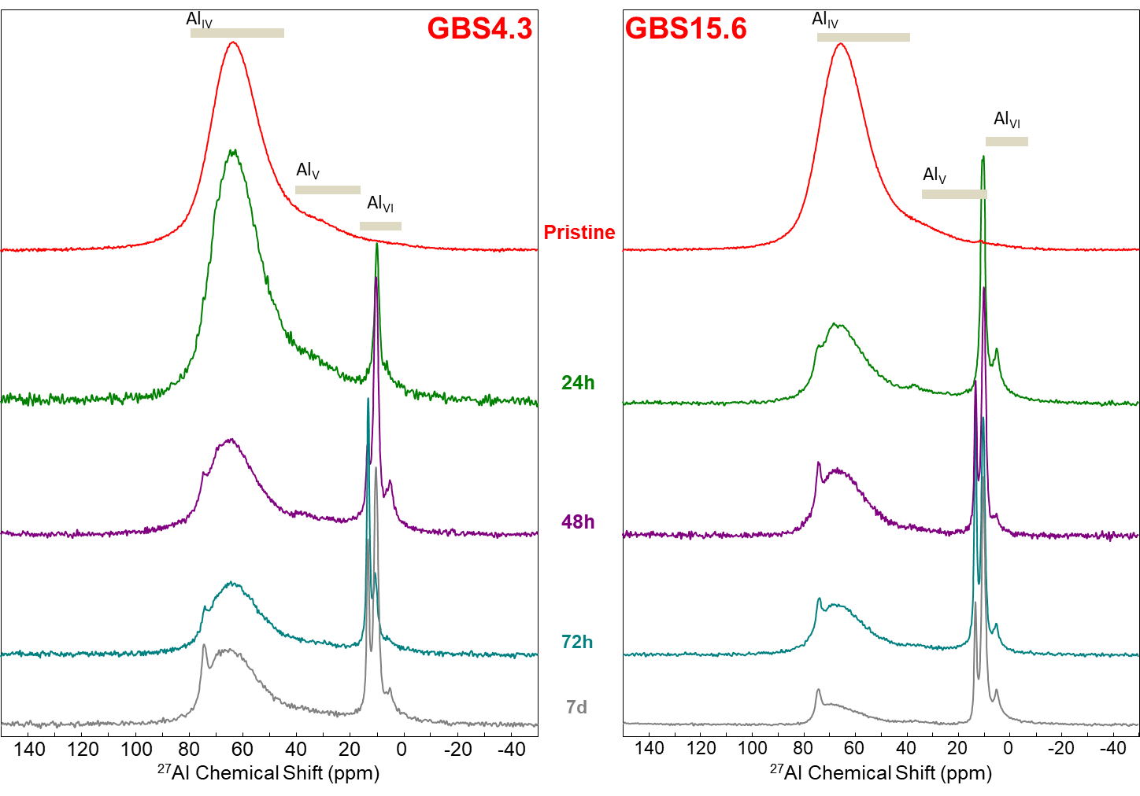
²⁷Al MAS NMR

Slide 24
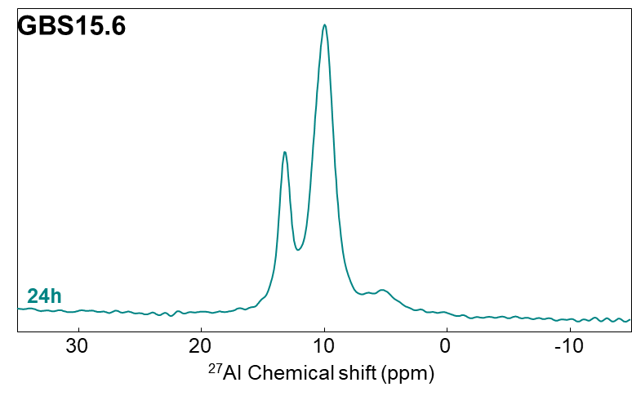
²⁷Al MAS NMR
AFm (10ppm)
Ettringite (13ppm)
TAH (5ppm)
Signal at 13ppm consistent with Ettringite
Large signal at 10ppm – Several components
  AFm phases
Signal at 5ppm consistent with Third Aluminum Hydrate
Andersen et. al. (2006). Cem. Concr. Res., 31(1), 3-17

Slide 25
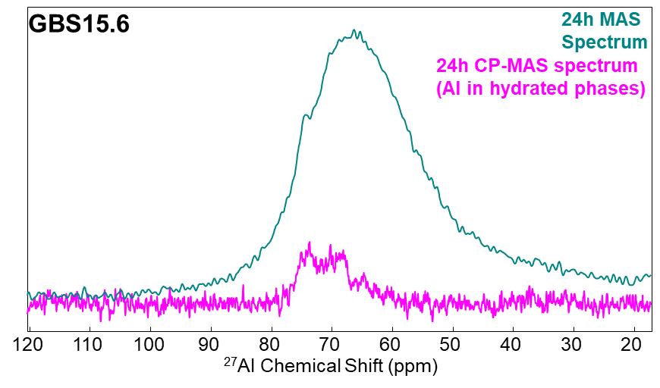

¹H-²⁷Al CP-MAS
Confirmation of the presence of hydrated phases under the unaltered slag signal
Signals at 74ppm and 68ppm consistent with CASH phases

Slide 26
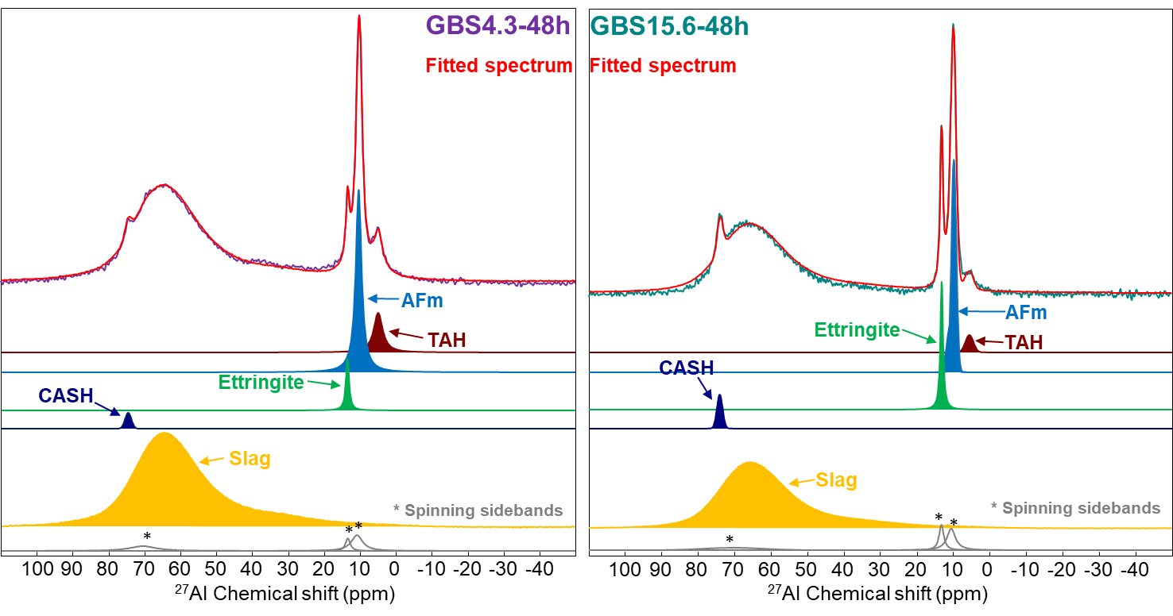
²⁷Al MAS NMR
 | GBS4.3-48h |  |  | GBS15.6-48h
 | δ_{iso} (ppm) | FWHM (ppm) | Al proportion (%) | δ_{iso} (ppm) | FWHM (ppm) | Al proportion (%)
CASH | 74.5 | 1.1 | 1 | 74.0 | 1.8 | 2
Ettringite | 13.5 | 1.1 | 2 | 13.1 | 0.9 | 7
AFm | 9.9/10.4 | 1.5/2.0 | 19 | 9.8/10.8 | 1.6/2.2 | 18
TAH | 4.9 | 3.0 | 5 | 5.6 | 2.6 | 2

Slide 27
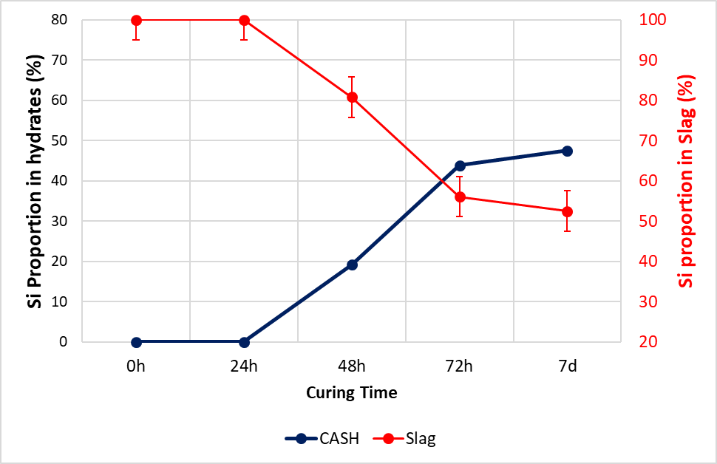
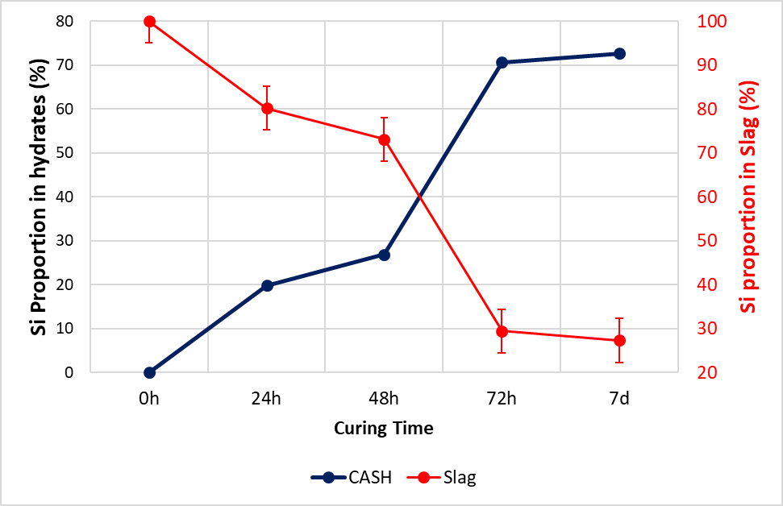
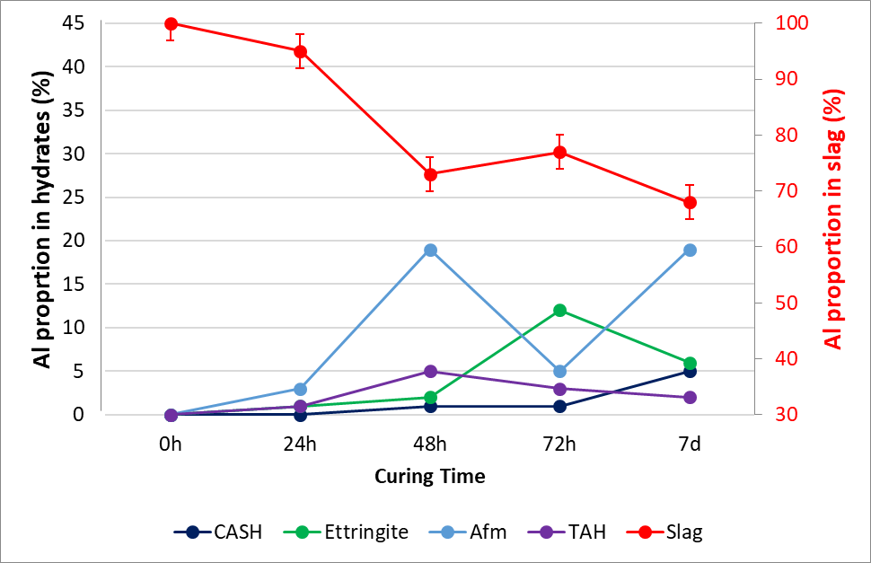
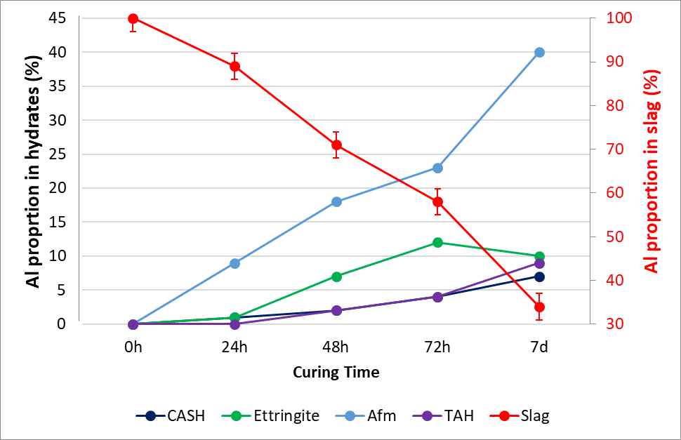
GBS4.3
Silicon
GBS15.6
Aluminum

Slide 28
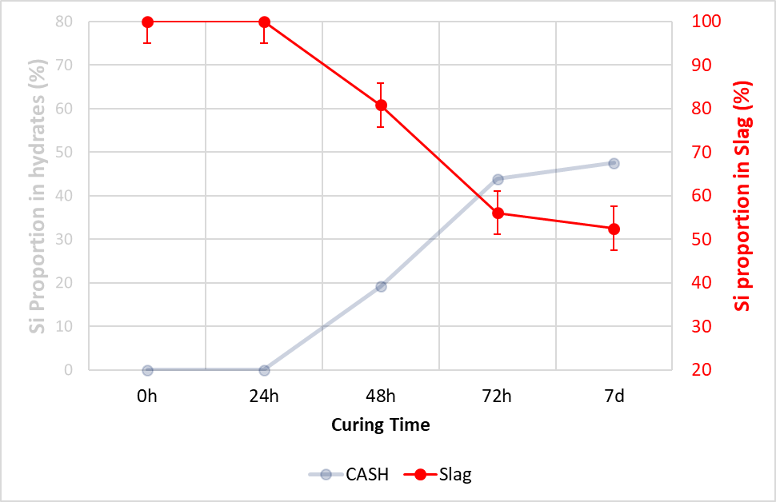
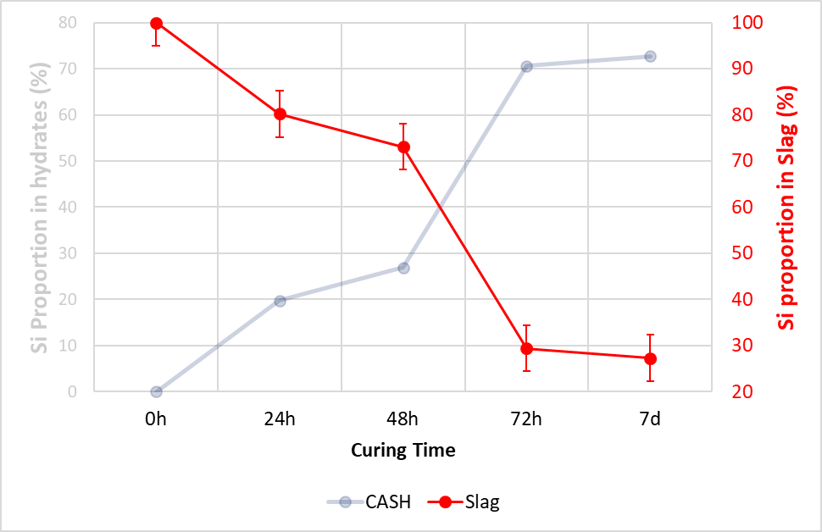
GBS4.3
Silicon
GBS15.6
Aluminum

Slide 29
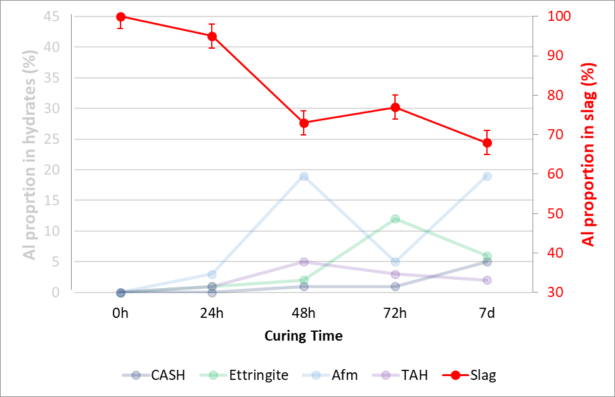
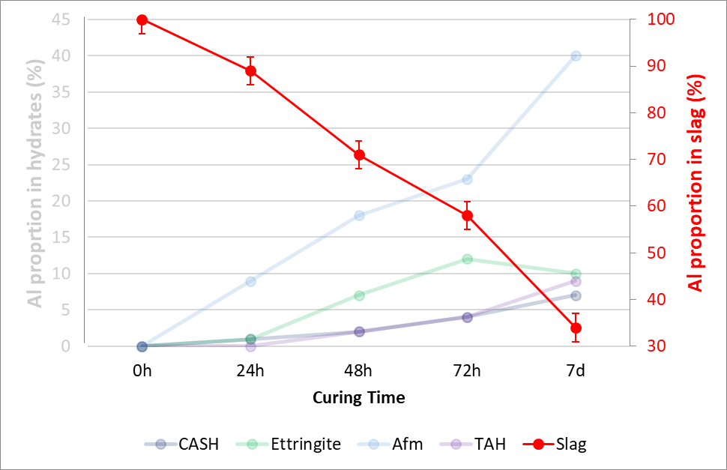
GBS4.3
Silicon
GBS15.6
Aluminum

Slide 30
GBS4.3
Silicon
GBS15.6
Aluminum

Slide 31
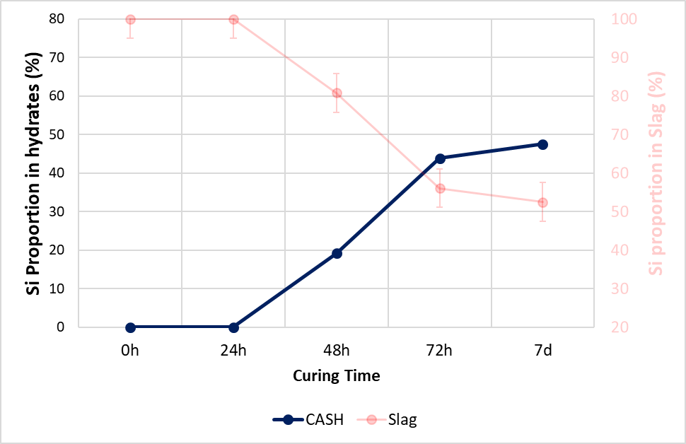
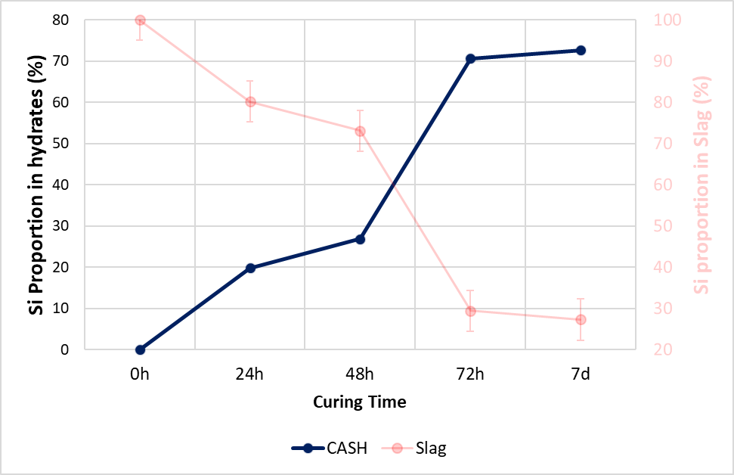
GBS4.3
Silicon
GBS15.6
Aluminum

Slide 32
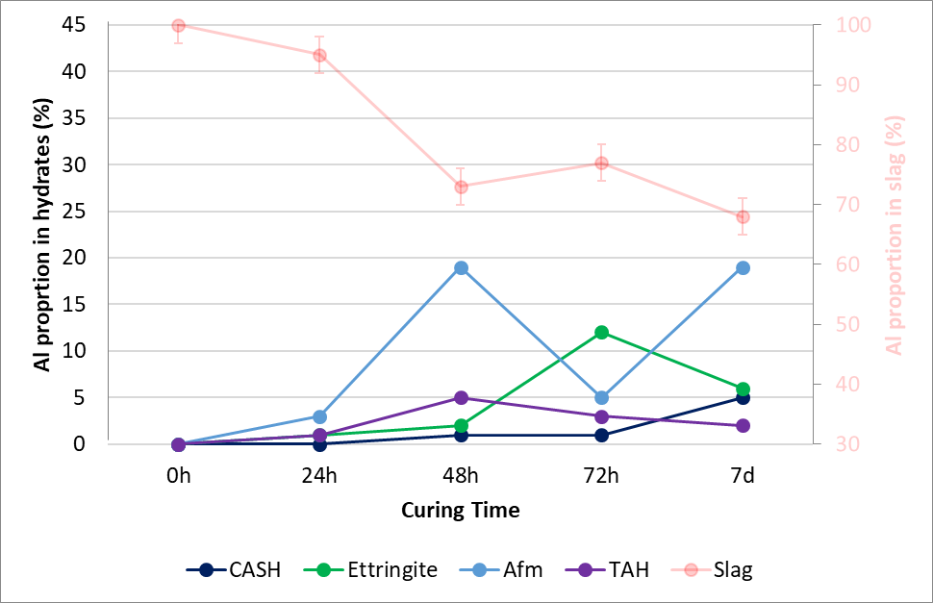
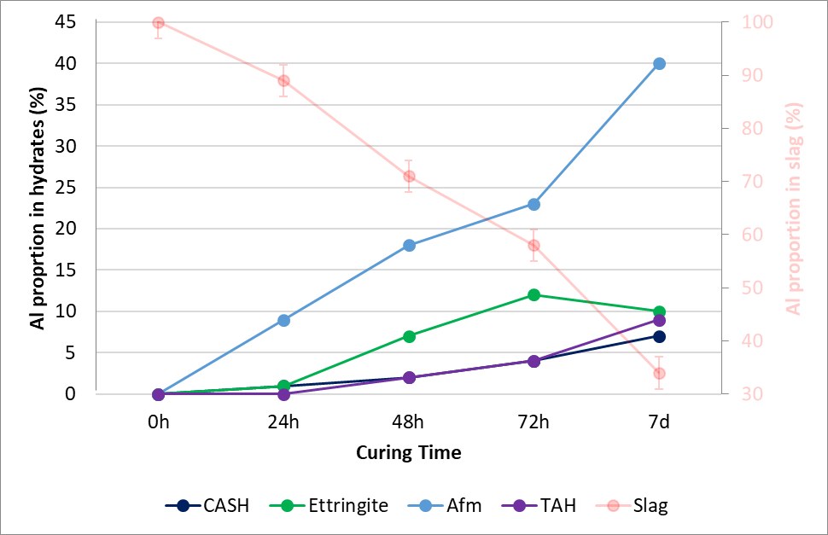
GBS4.3
Silicon
GBS15.6
Aluminum

Slide 33
GBS4.3
Silicon
GBS15.6
Aluminum

Slide 34
Conclusion
Less polymerized sample GBS15.6 (higher basicity) – faster and more important dissolution
GBS4.3:
  Late onset of slag dissolution – 48h for Si and 24h for Al
  After 7 days – 48% of Si and 32% of Al have leached out
  CASH detected after 48h for Si
GBS15.6:
  Early onset of slag dissolution –24h
  After 7 days – 70% of Si and 65% of Al have leached out
  CASH detected as soon as 24h
Consistent with known negative impact attributed toTitanium
    Current work…
Effect of crystalline phases..?

Slide 35
GBS15.6 - Dark and Light parts
Separate study of dark and light grains:
GBS15.6
AFm
Ettringite
TAH
Light-24h
Dark-24h
140
120
100
80
60
40
20
0
-20
-40
²⁷Al Chemical Shift (ppm)
After 24h – Formation of Ettringite in the Light part only
Different phase development
Effect of crystallinity

Slide 36



Acknowledgments
Our Partners:
NMR (CEMHTI):
Valérie Montouillout, Franck Fayon, Catherine Bessada
Andreas Ehrenberg
Judit Kaknics, Gilles Franceschini, François Hanrot
XRD and Microscopy (CEMHTI):
Cécile Genevois, Mathieu Allix, Emmanuel Véron
Joachim Deubener, Hansjörg Bornhöft, Daniel Hart, Natalja Pronina
EPR Measurements (LASIR):
Charles-Emmanuel Dutoit (CEMHTI), Hervé Vezin (LASIR)
Simon Blotevogel, Lola Doussang , Cédric Patapy, Martin Cyr
Laurent Steger, Laurent Frouin
Funding:
This project has received funding from the Research Fund for Coal and Steel under grant agreement No 74809
Thank you for your attention!

Slide 37
